Slide 1

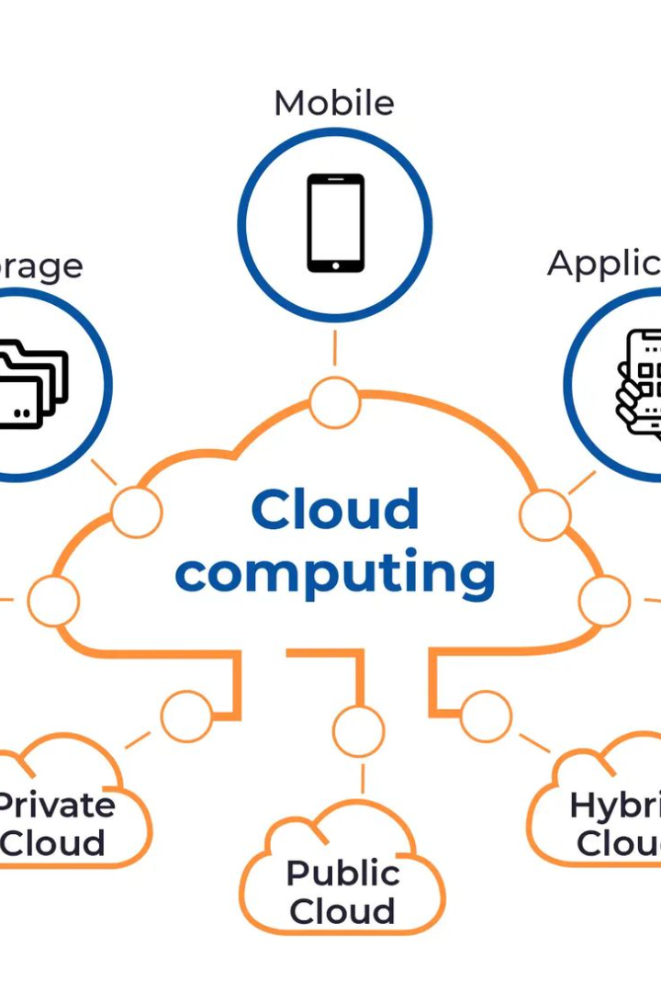

The Beauty and Power of Cloud Computing
Discover how the cloud has revolutionized the way we work, store data, and connect with others. Join us on a journey through the clouds!
by Devil's Customs

Slide 2
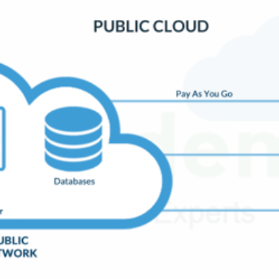
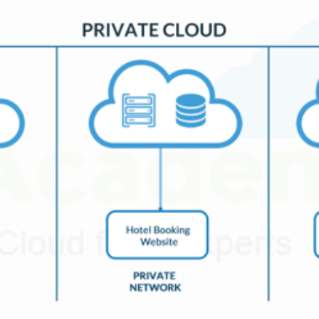

The Many Forms of Cloud Computing
Public
Private
Hybrid
Companies like Amazon and Google offer computing resources on a pay-per-use model.
Companies operate their own data centers to store and manage their data.
A combination of public and private clouds to take advantage of the best features of both.

Slide 3
Advantages of Cloud Computing
Flexible
Cloud resources can be scaled up or down as needed - perfect for a growing business.
1
2
3
Cost-effective
Collaborative
No need to invest in expensive hardware or software. Pay for what you need only.
Cloud platforms allow for collaboration from anywhere in the world, increasing productivity.

Slide 4
Challenges of Cloud Computing
Data Privacy
Downtime
Integration
Storing data in the cloud can raise concerns about privacy and security.
Cloud systems can experience downtime, disrupting your business operations.
Integrating cloud computing with existing computer systems can be challenging.
Technical Support
Getting technical support can be difficult, especially for small businesses.

Slide 5
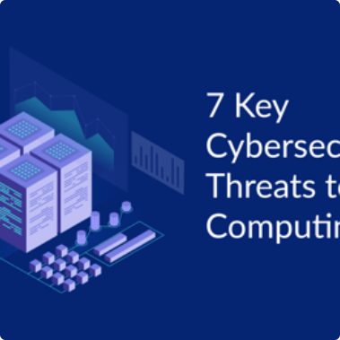

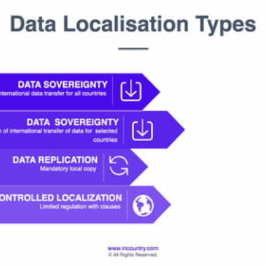
Security in the Cloud
Threats
Measures
Compliance
Cloud computing poses security threats like unauthorized access, data breaches, and malicious attacks.
Steps like encryption, regular audits, and access controls can help mitigate these threats.
Many industries have specific compliance standards for cloud computing, like HIPAA for healthcare data.

Slide 6
The Future of Cloud Computing
1
AI Integration
Artificial intelligence is being integrated with cloud computing to provide even more advanced services.
2
Edge Computing
Edge computing brings the power of the cloud closer to the end-user by processing data locally.
3
Quantum Computing
Quantum computing is poised to revolutionize cloud computing with its ability to solve complex problems quickly.

Slide 7

In Conclusion
Cloud computing is a powerful tool that can help businesses grow and thrive.
It comes with its own set of challenges and concerns, but these can be mitigated with proper security measures and compliance standards.
The future of cloud computing is exciting, with AI integration, edge computing, and quantum computing all poised to transform the industry.

