Slide 1
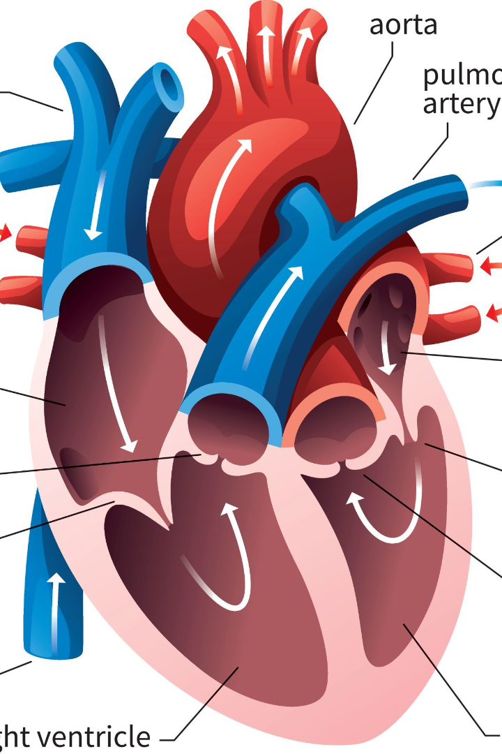

The Human Heart: Understanding the Cardiac Cycle
The heart is an amazing organ that constantly pumps blood throughout the body to sustain life. In this presentation, we'll explore the fascinating cardiac cycle and its intricate mechanisms.
by Devil's Customs

Slide 2
Structure and Function of Cardiac Muscle Cells
Shape and Size
Functional Properties
Intercalated Discs
Cardiac muscle cells are cylindrical and smaller than skeletal muscle cells, with a single nucleus and striated appearance.
Cardiac muscle cells are involuntary, meaning they contract automatically in response to electrical impulses from the heart's pacemaker cells.
These specialized structures join adjacent cardiac muscle cells and help transmit electrical signals quickly, ensuring coordinated contraction.
Cardiac Output
The amount of blood pumped by each ventricle in one minute, is the product of heart rate and stroke volume and is measured in liters per minute.

Slide 3
Electrical Events during the Cardiac Cycle
AV Node Delay
The atrioventricular (AV) node briefly delays the impulse, allowing the ventricles to fill with blood.
1
2
3
SA Node Depolarization
Bundle of His and Purkinje Fibers
The sinoatrial (SA) node initiates the impulse that spreads through the atria, causing them to contract.
The impulse rapidly travels through the bundle of His and Purkinje fibers, causing the ventricles to contract.

Slide 4
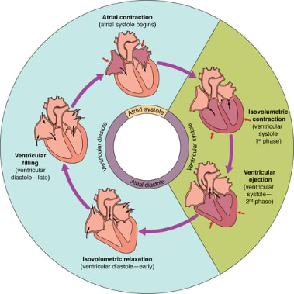
Phases of the Cardiac Cycle: Systole and Diastole
Systole
Diastole
Heart Sounds
The phase in which the ventricles contract and blood is ejected into the aorta and pulmonary artery.
The phase in which the ventricles relax and fill with blood from the atria.
The characteristic "lub-dub" sound of the heartbeat corresponds to the closing of the heart valves.

Slide 5
Cardiac Output Regulation
1
Sympathetic Nervous System
Stress or exercise activates the "fight or flight" response, causing increased heart rate and contractility to meet the body's needs.
2
Parasympathetic Nervous System
During rest, the "rest and digest" response dominates, slowing heart rate and reducing contractility to conserve energy.
3
Frank-Starling Law
A mechanism by which the heart adjusts its stroke volume in response to changes in venous return, so that cardiac output remains constant.

Slide 6

Common Cardiac Cycle Disorders
1
Arrhythmia
2
Heart Failure
Abnormal heart rhythm, which may lead to palpitations or dizziness.
The heart's inability to pump enough blood to meet the body's demands, leading to shortness of breath and other symptoms.
3
Cardiac Arrest
Sudden loss of heart function, which can be fatal within minutes if not treated promptly.

Slide 7
Medical Treatments for Cardiac Cycle Disorders
Medication Therapy
Implantable Devices
Surgery
Drugs that help regulate heart rhythm, increase cardiac output, or reduce blood pressure.
Pacemakers or defibrillators that can help regulate heart function or correct arrhythmias.
Certain cardiac disorders may require surgical intervention, such as valve replacement or bypass surgery.

